Slide 1
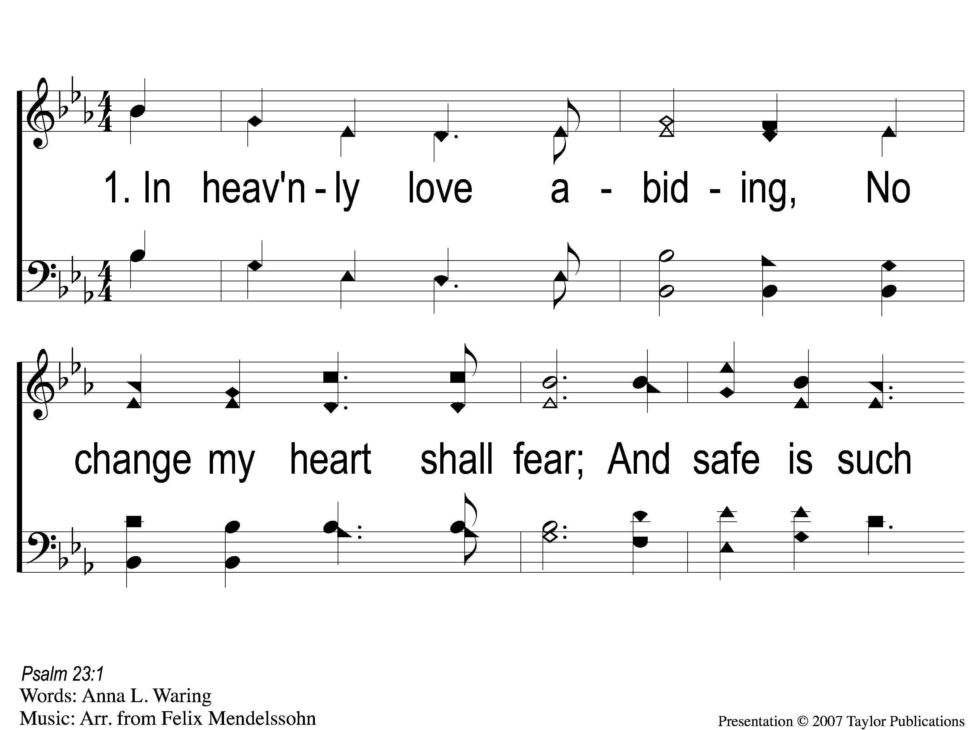
1-1 In Heavenly Love
In Heavenly Love Abiding
125

Slide 2
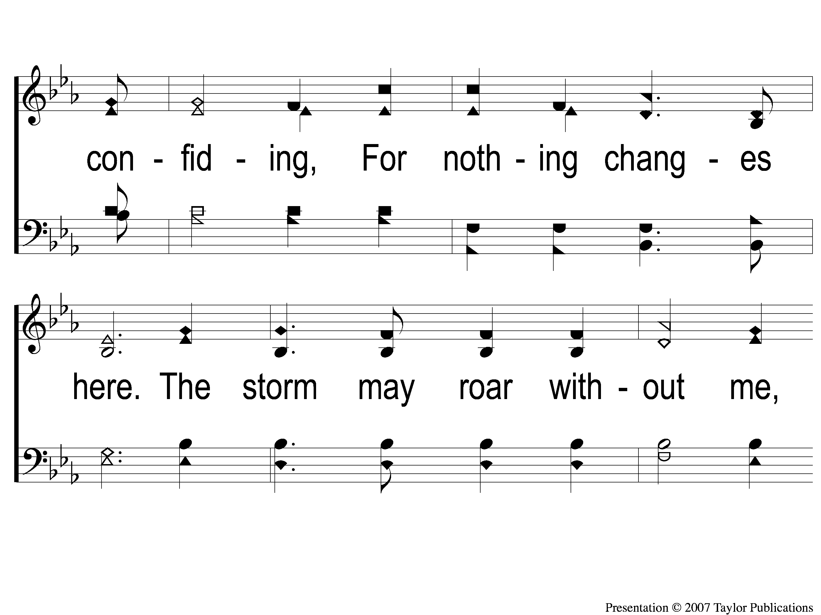
1-2 In Heavenly Love
In Heavenly Love Abiding
125

Slide 3
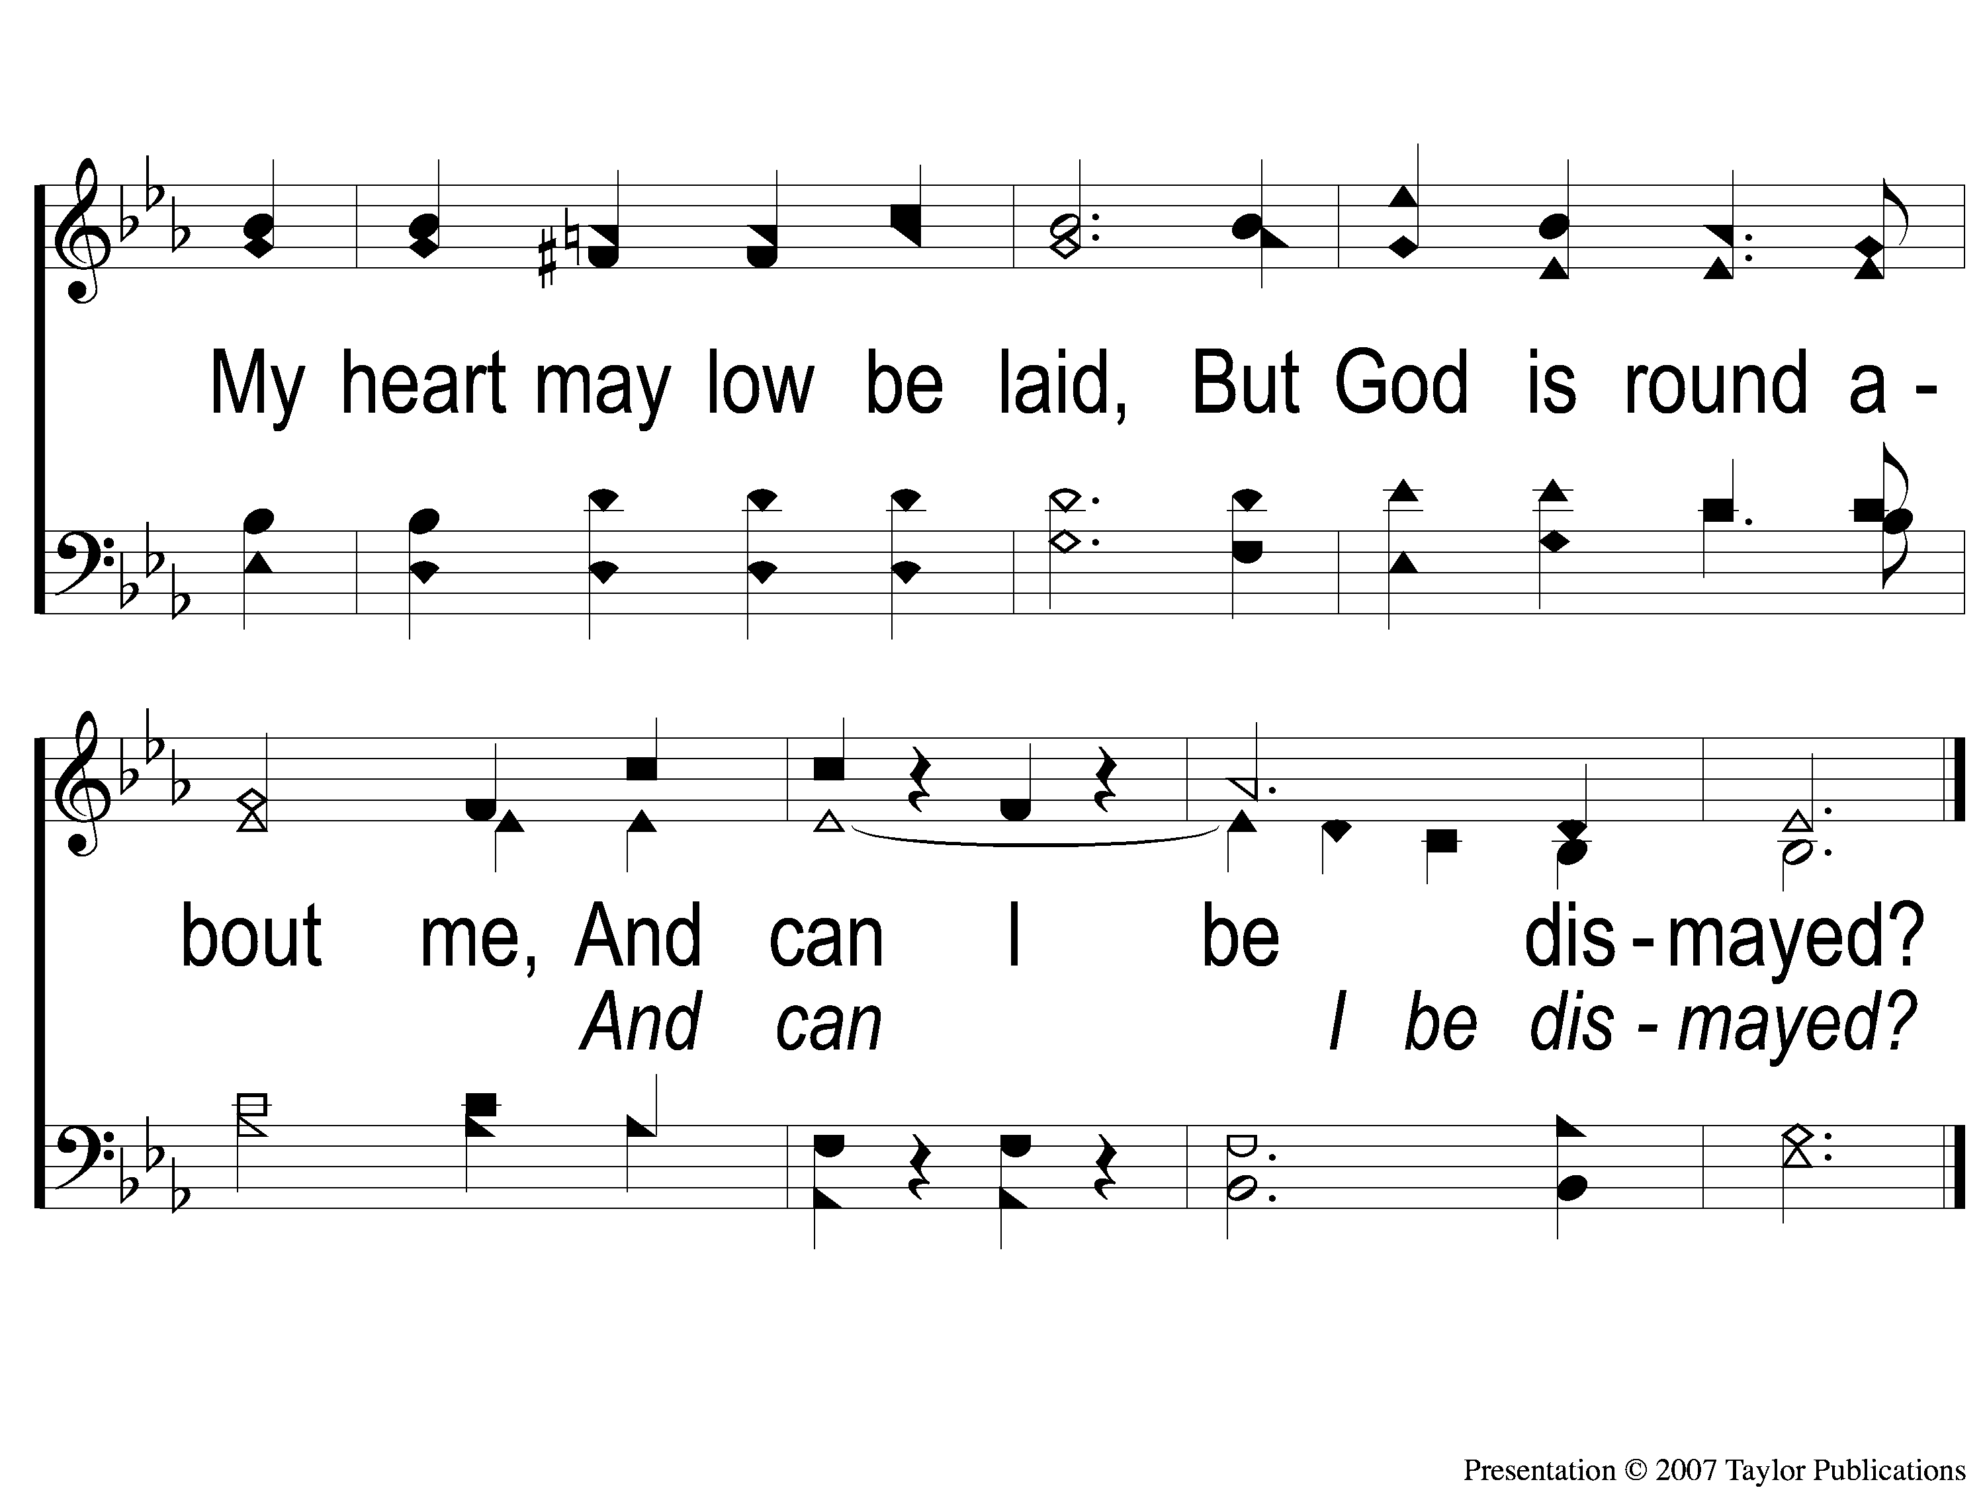
1-3 In Heavenly Love
In Heavenly Love Abiding
125

Slide 4
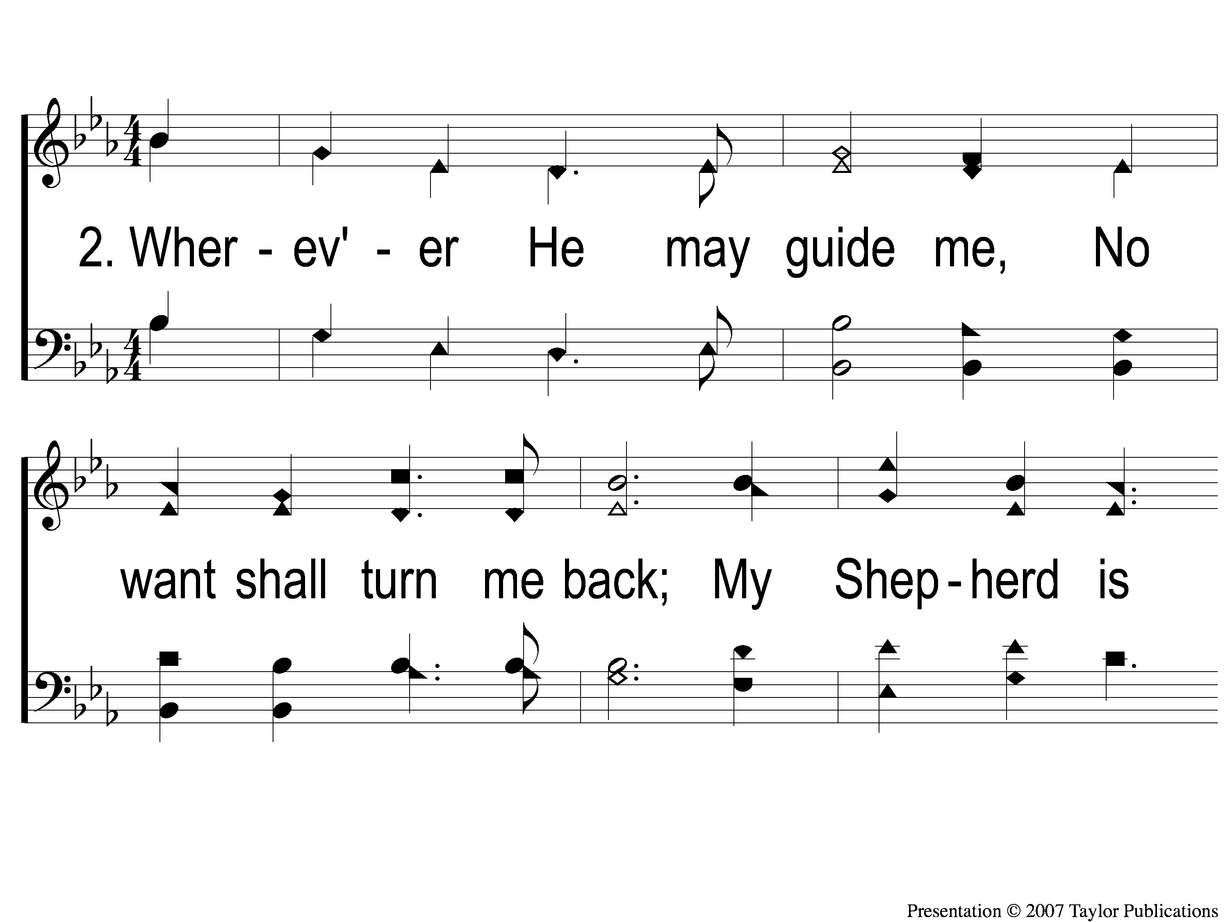
2-1 In Heavenly Love
In Heavenly Love Abiding
125

Slide 5
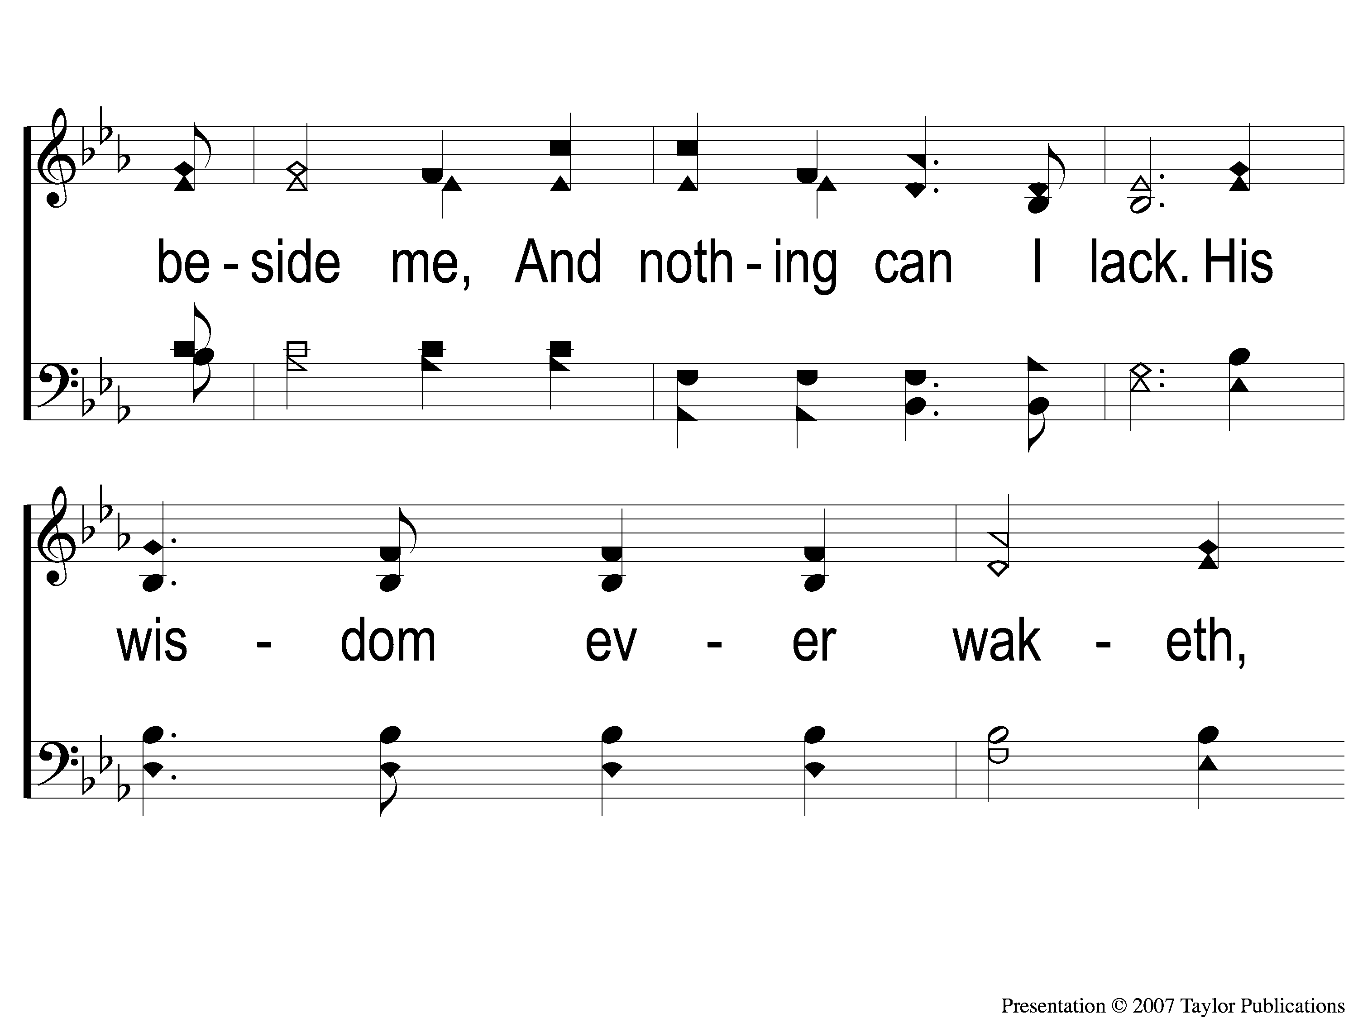
2-2 In Heavenly Love
In Heavenly Love Abiding
125

Slide 6
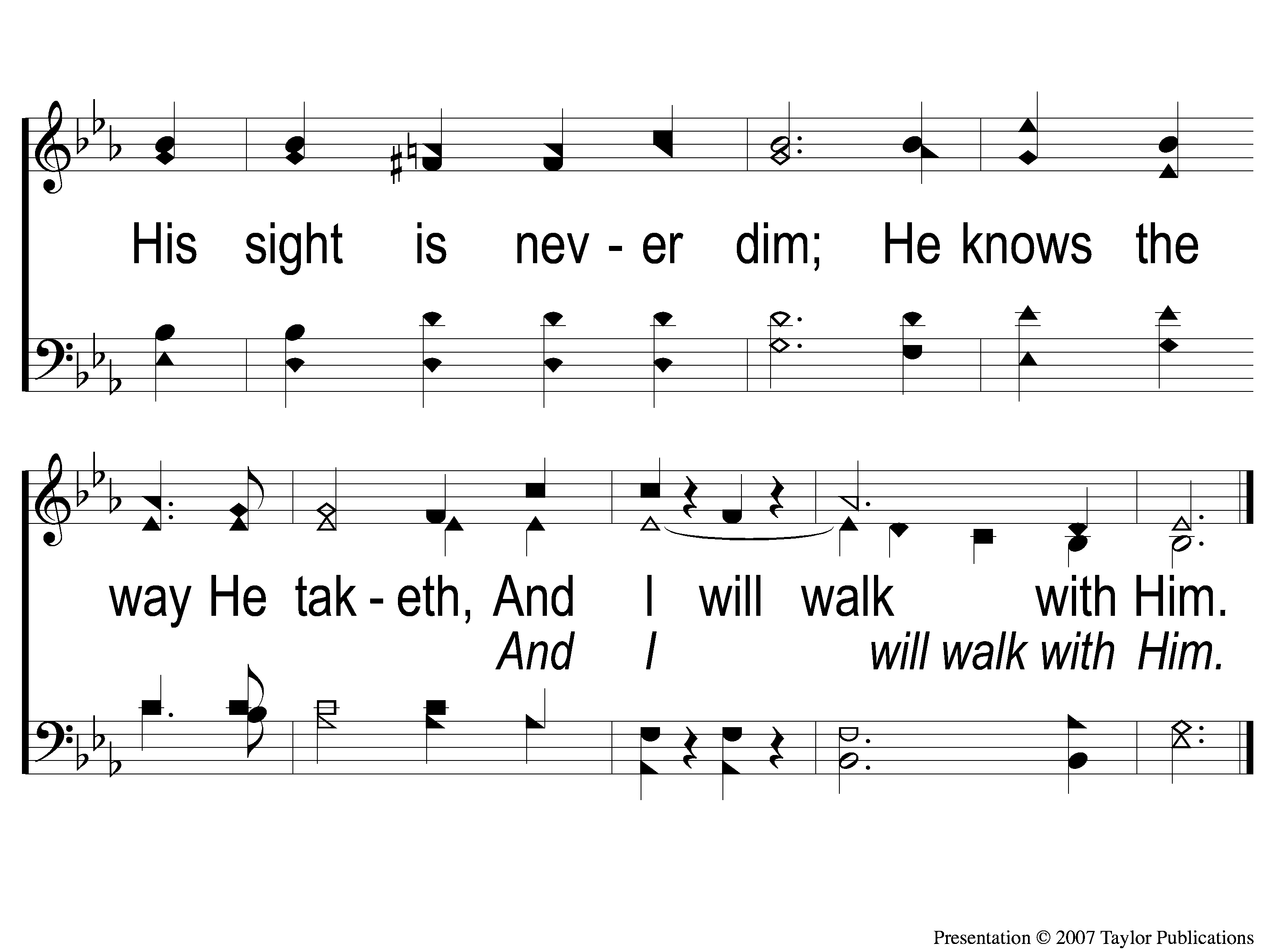
2-3 In Heavenly Love
In Heavenly Love Abiding
125

Slide 7
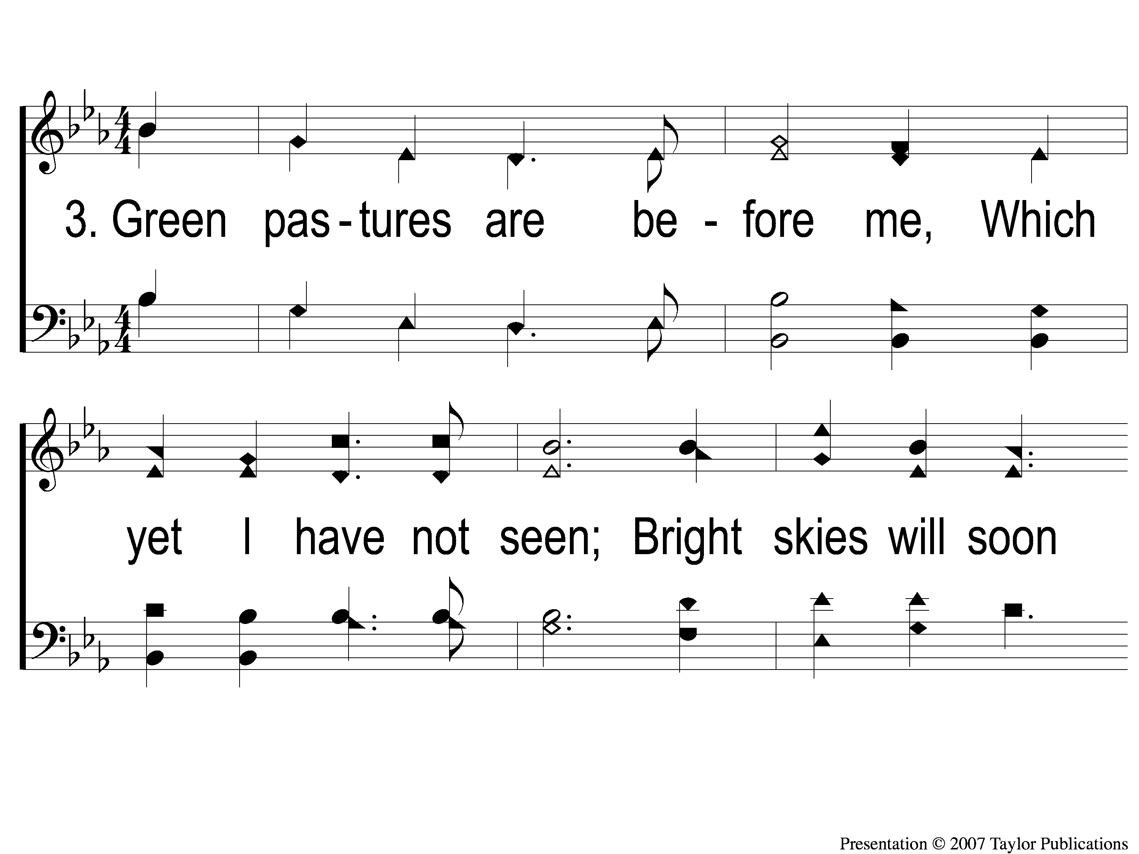
3-1 In Heavenly Love
In Heavenly Love Abiding
125

Slide 8
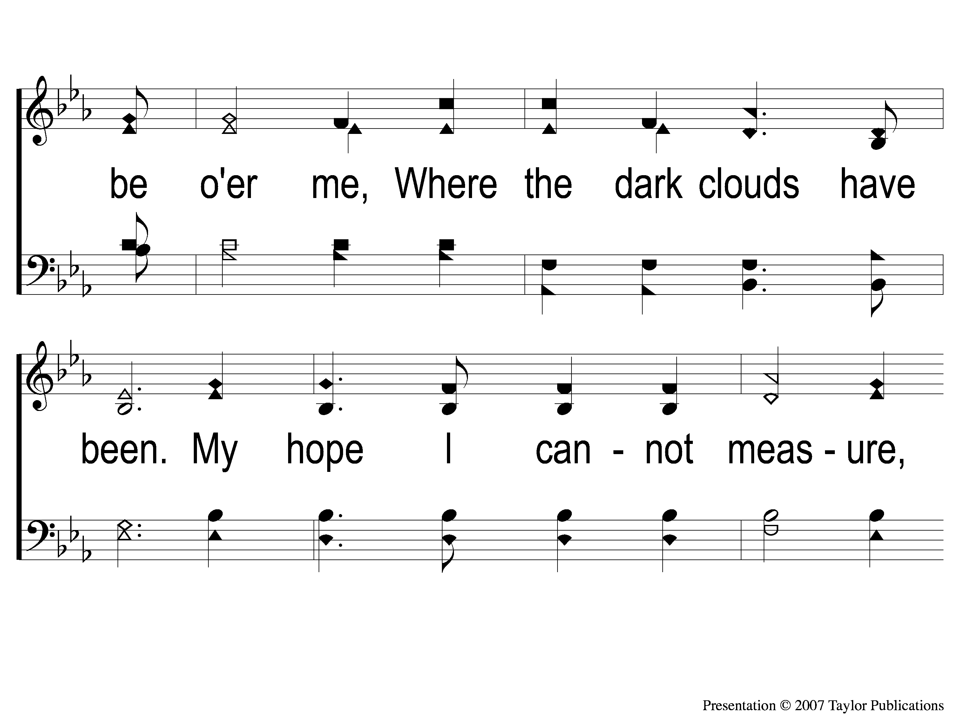
3-2 In Heavenly Love
In Heavenly Love Abiding
125

Slide 9
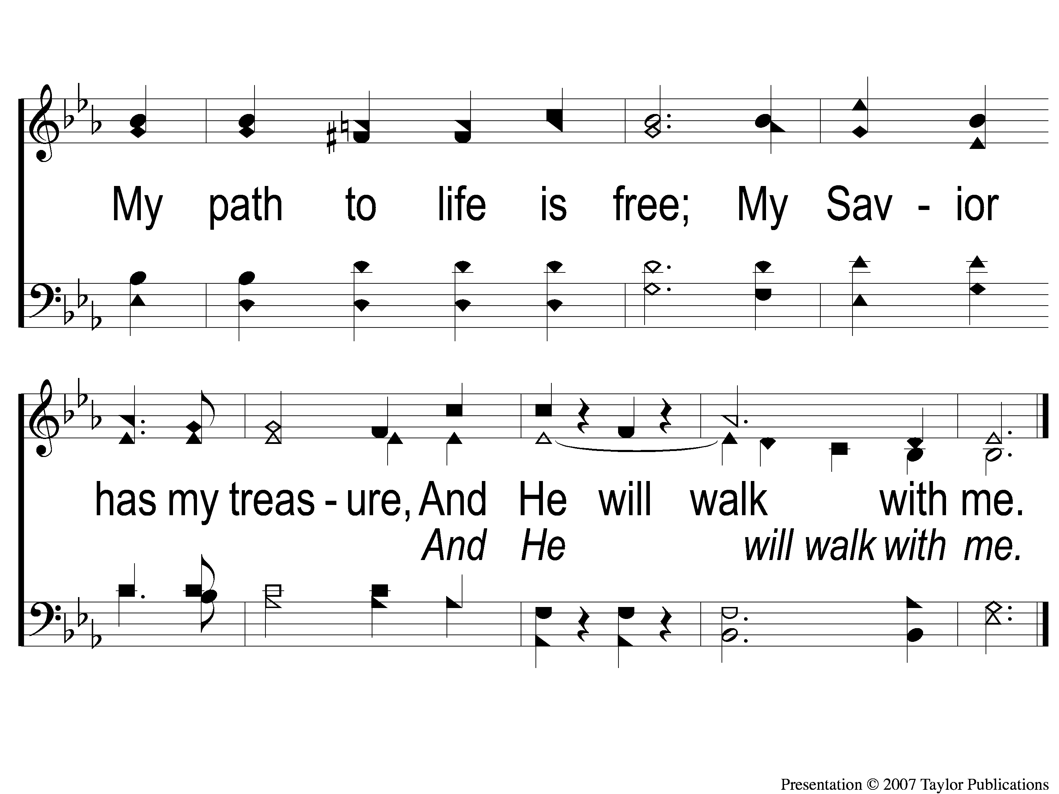
3-3 In Heavenly Love
In Heavenly Love Abiding
125

